Slide 1
Cell Line Development for Biopharmaceutical Manufacturing: A Review of Recent Advances and the Productivity Gains Achieved Justyna Skiba S00274779
STUDENT PRESENTATION

Slide 2
Introduction
Overview:
Transition from basic cell lines to precision-based methods.
Significance:
product yields, time-to-market, and product quality.

Slide 3
Traditional Methods and Limitations
Traditional Methods
Limitations

Slide 4
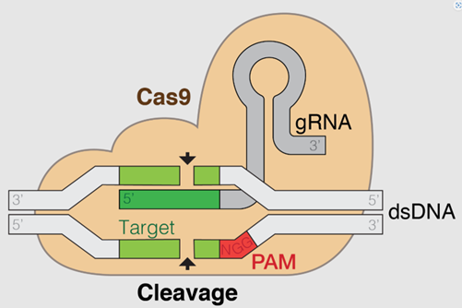
Gene Editing Technologies
CRISPR-Cas9

Slide 5
Advanced Cell Culture Systems
3D cell culture
Perfusion

Slide 6
Omics Technologies
Overview
Applications

Slide 7
Automation and High-Throughput Screening
Key Innovations
Benefits

Slide 8
Productivity Gains
Increased Yields
Reduced Time-to-Market
Improved Product Quality

Slide 9
Conclusion
Key Takeaways:
Advancements have transformed cell line development, ensuring cost-efficiency and quality. CRISPR, 3D culture, omics, and automation are pivotal.
Future Directions:
Further optimization of AI tools, omics technologies, and perfusion culture scalability.

Slide 10
Thank You

